Slide 1
Machine Learning
Machine learning
Prepared by Srujan

Slide 2
Agenda
ML Intro
Supervised ML
Linear Regression Supervised ML
Classification Supervised ML
Metrices of Linear Regression
Metrices of Classification
Examples

Slide 3
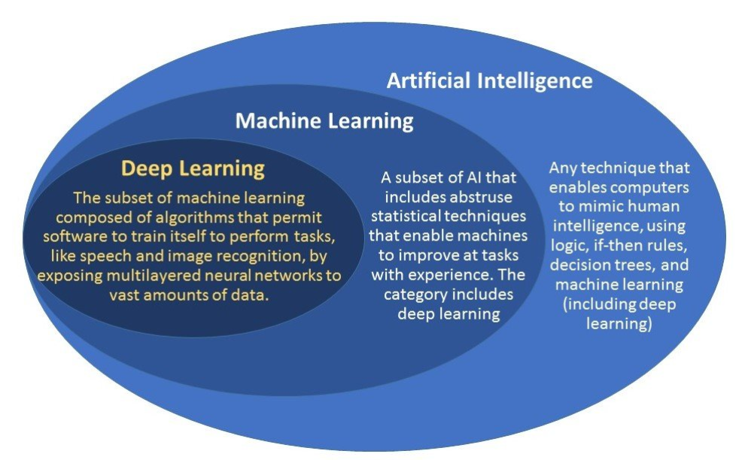

Slide 4
Machine learning is a subset of AI. The theory is simple, machines take data and ‘learn’ for themselves. It is currently the most promising tool in the AI pool for businesses. Machine learning systems can quickly apply knowledge and training from large datasets to excel at facial recognition, speech recognition, object recognition, translation, and many other tasks. Machine learning allows a system to learn to recognize patterns on its own and make predictions, contrary to hand-coding a software program with specific instructions to complete a task

Slide 5
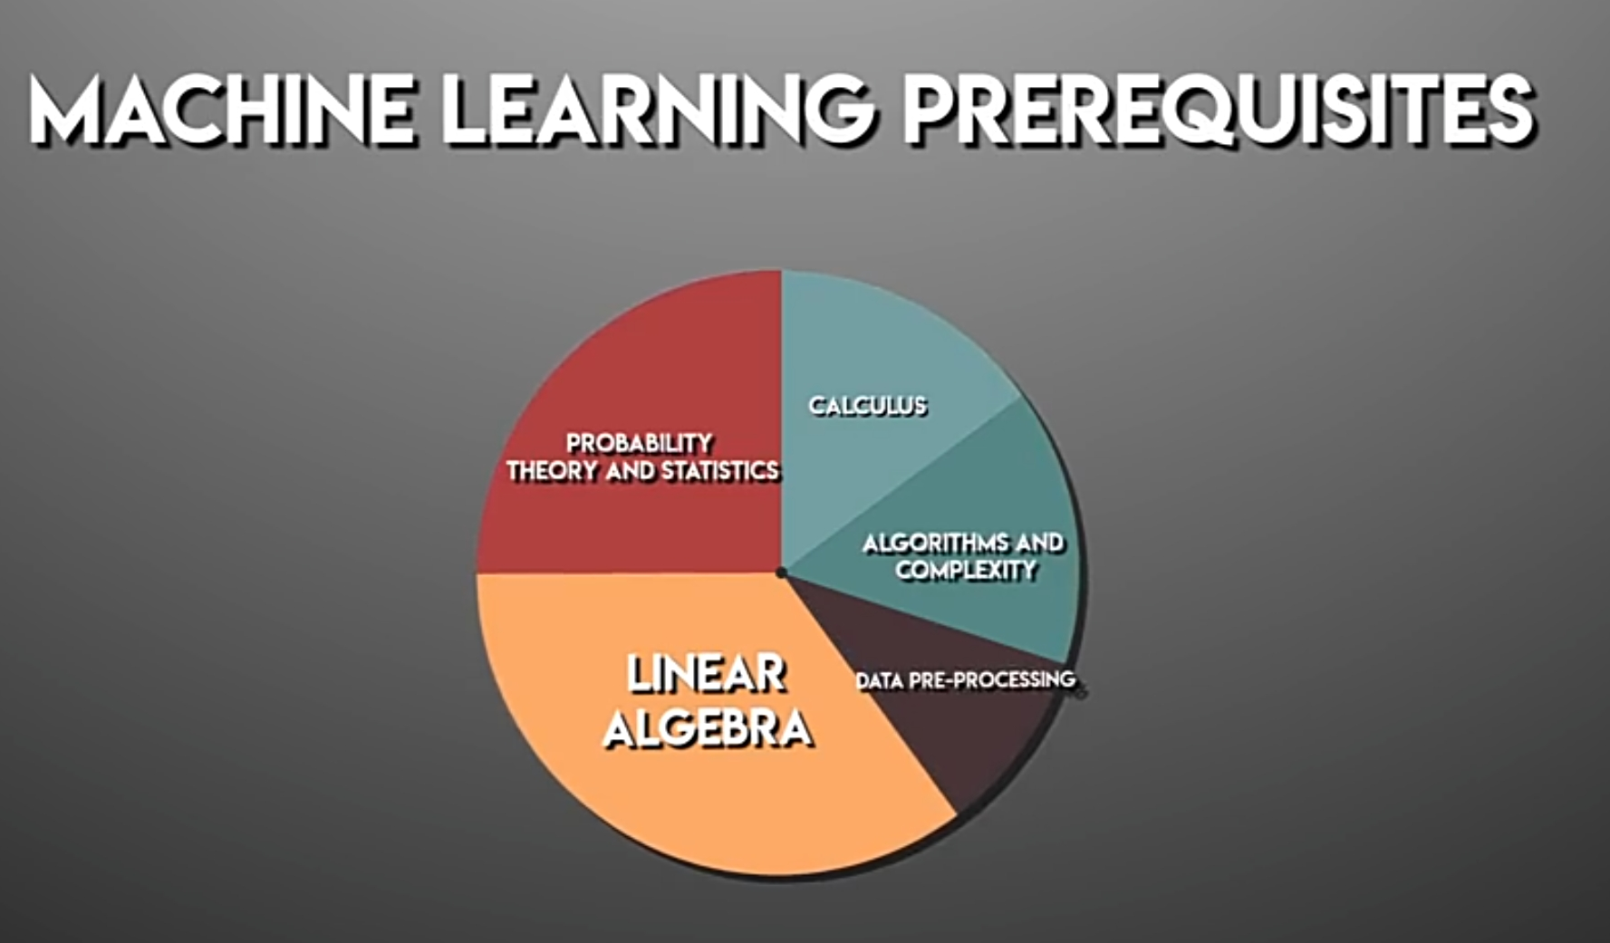

Slide 6
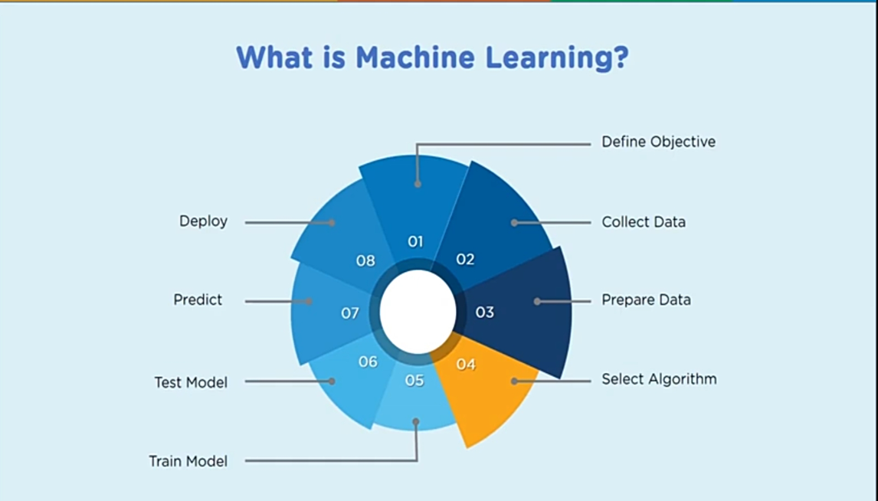

Slide 7
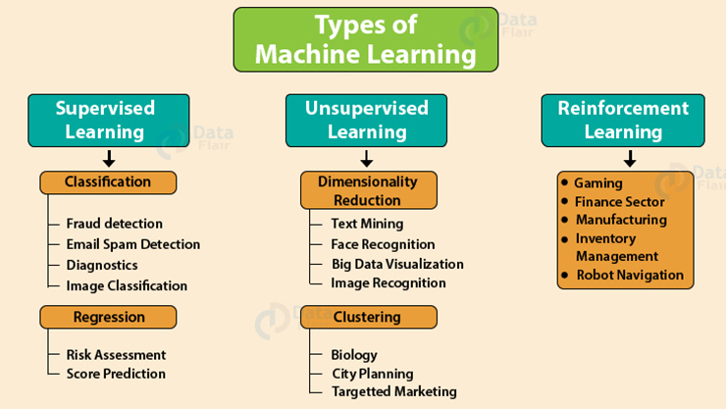
Supervised
Un-supervised
Reinforcement

Slide 8
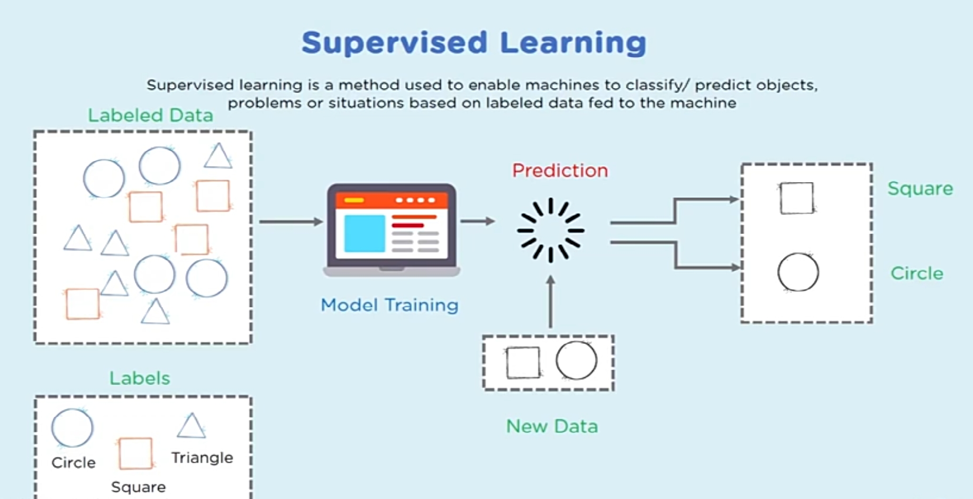

Slide 9
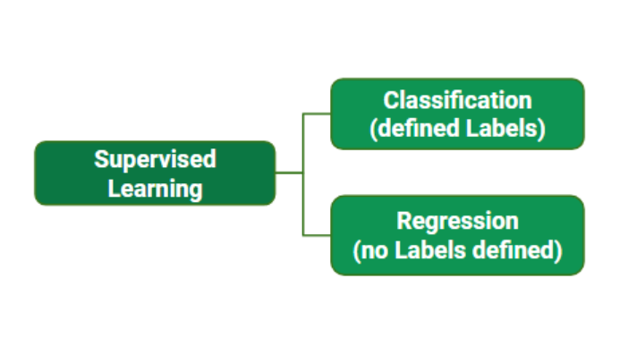
Supervised Learning : Supervised learning is when the model is getting trained on a labelled dataset. Labelled dataset is one which have both input and output parameters. In this type of learning both training and validation datasets are labelled as shown in the figures below.

Slide 10
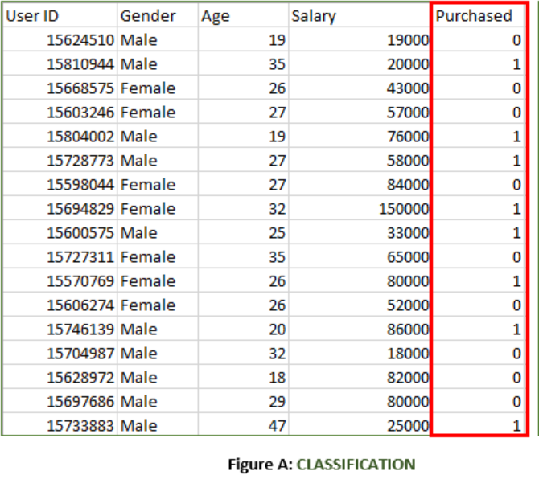
Classification : It is a Supervised Learning task where output is having defined labels(discrete value)
It is a dataset of a shopping store which is useful in predicting whether a customer will purchase a particular product under consideration or not based on his/ her gender, age and salary. Input : Gender, Age, Salary Output : Purchased i.e. 0 or 1 ; 1 means yes the customer will purchase and 0 means that customer won’t purchase it.

Slide 11
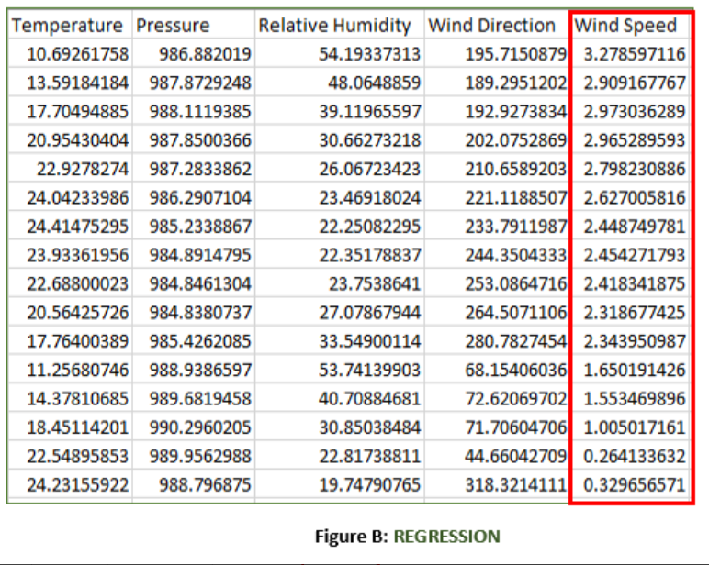
Regression : It is a Supervised Learning task where output is having continuous value.
It is a Meteorological dataset which serves the purpose of predicting wind speed based on different parameters. Input : Dew Point, Temperature, Pressure, Relative Humidity, Wind Direction Output : Wind Speed

Slide 12
Linear Regression

Slide 13
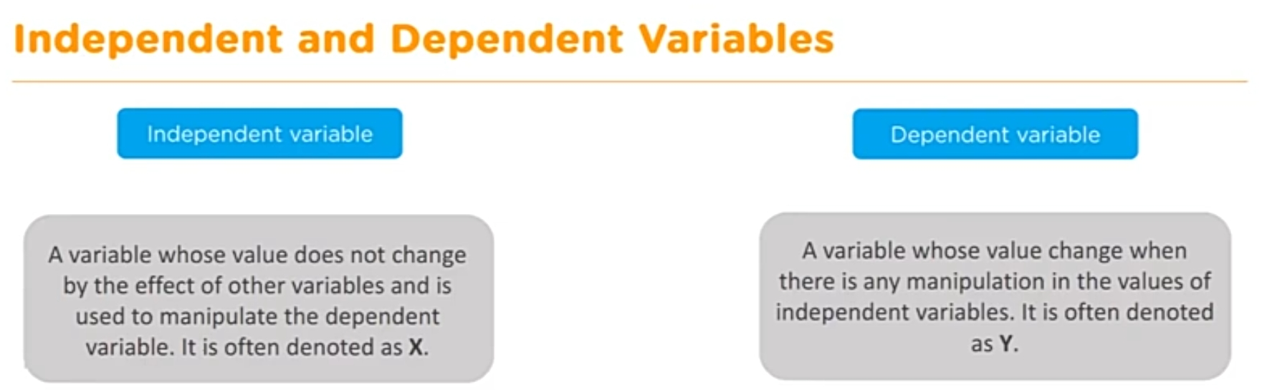

Slide 14
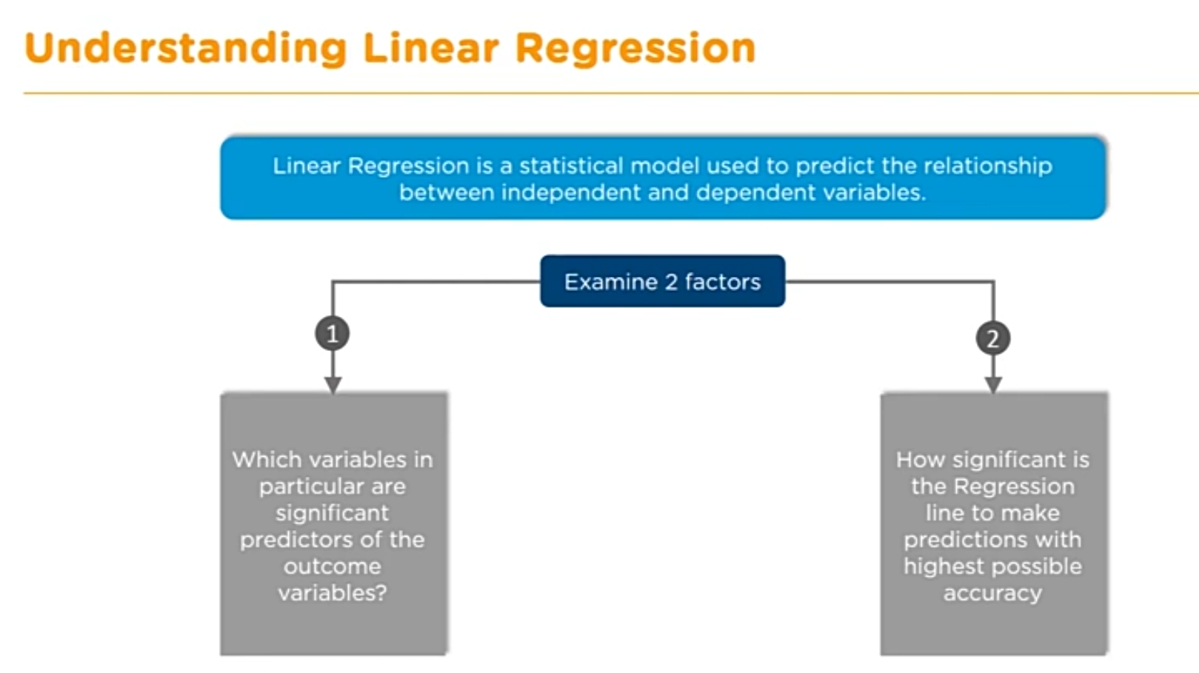

Slide 15
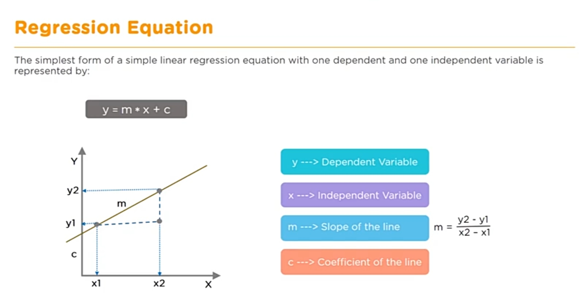

Slide 16
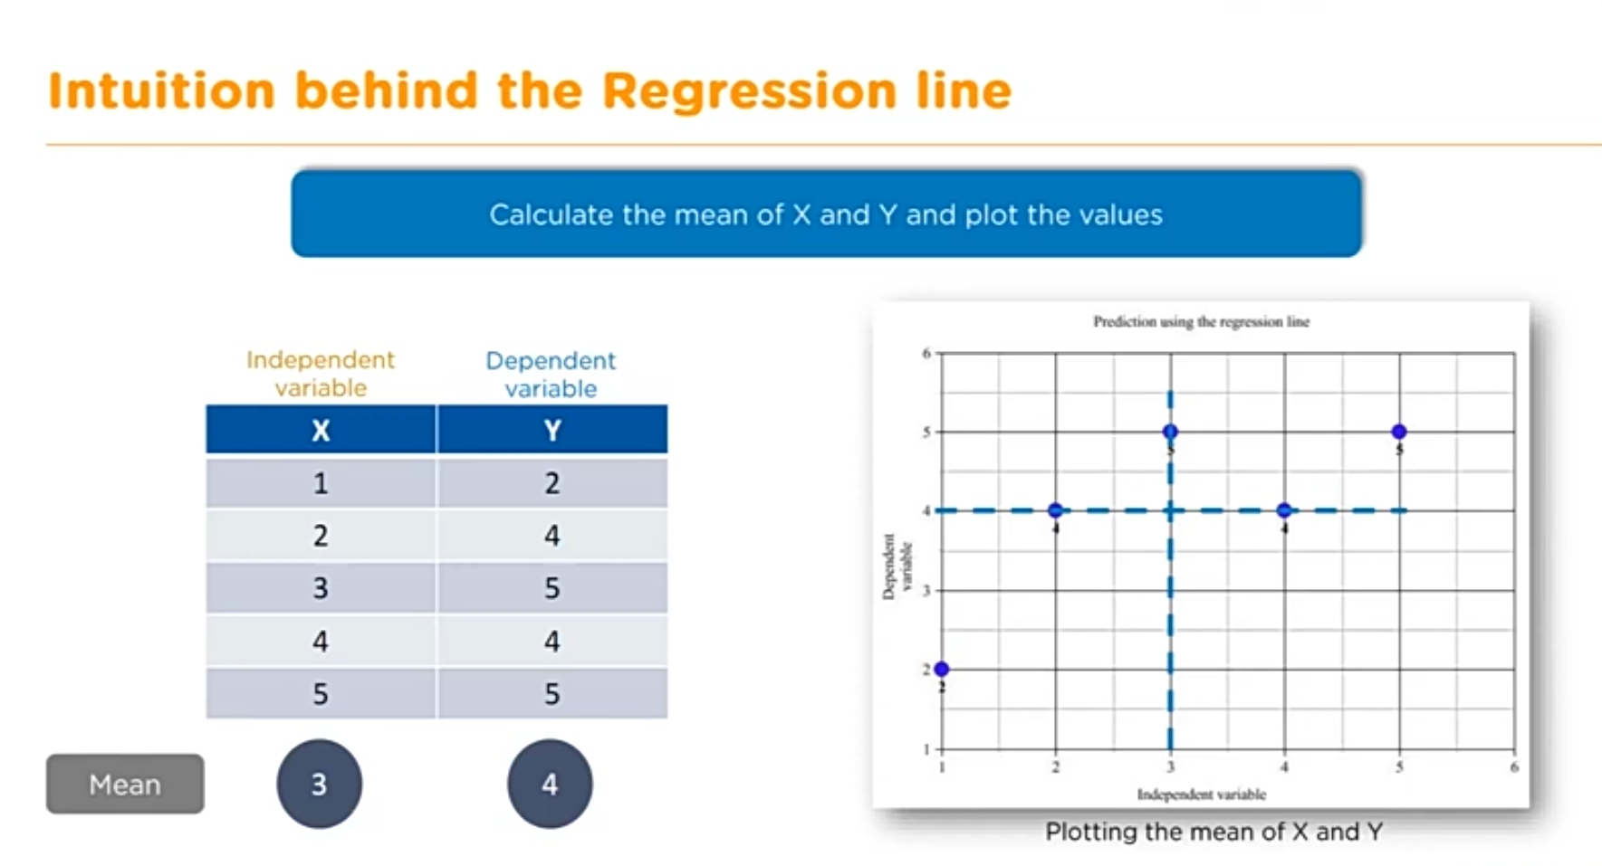

Slide 17
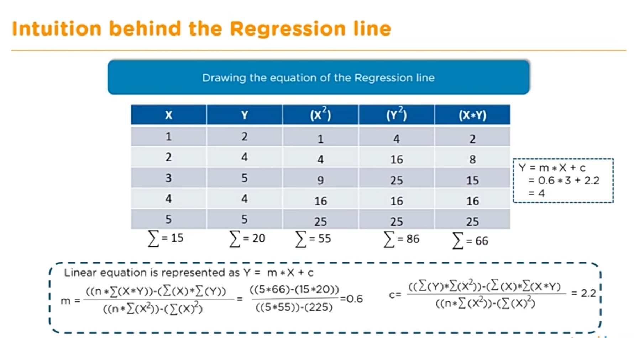

Slide 18
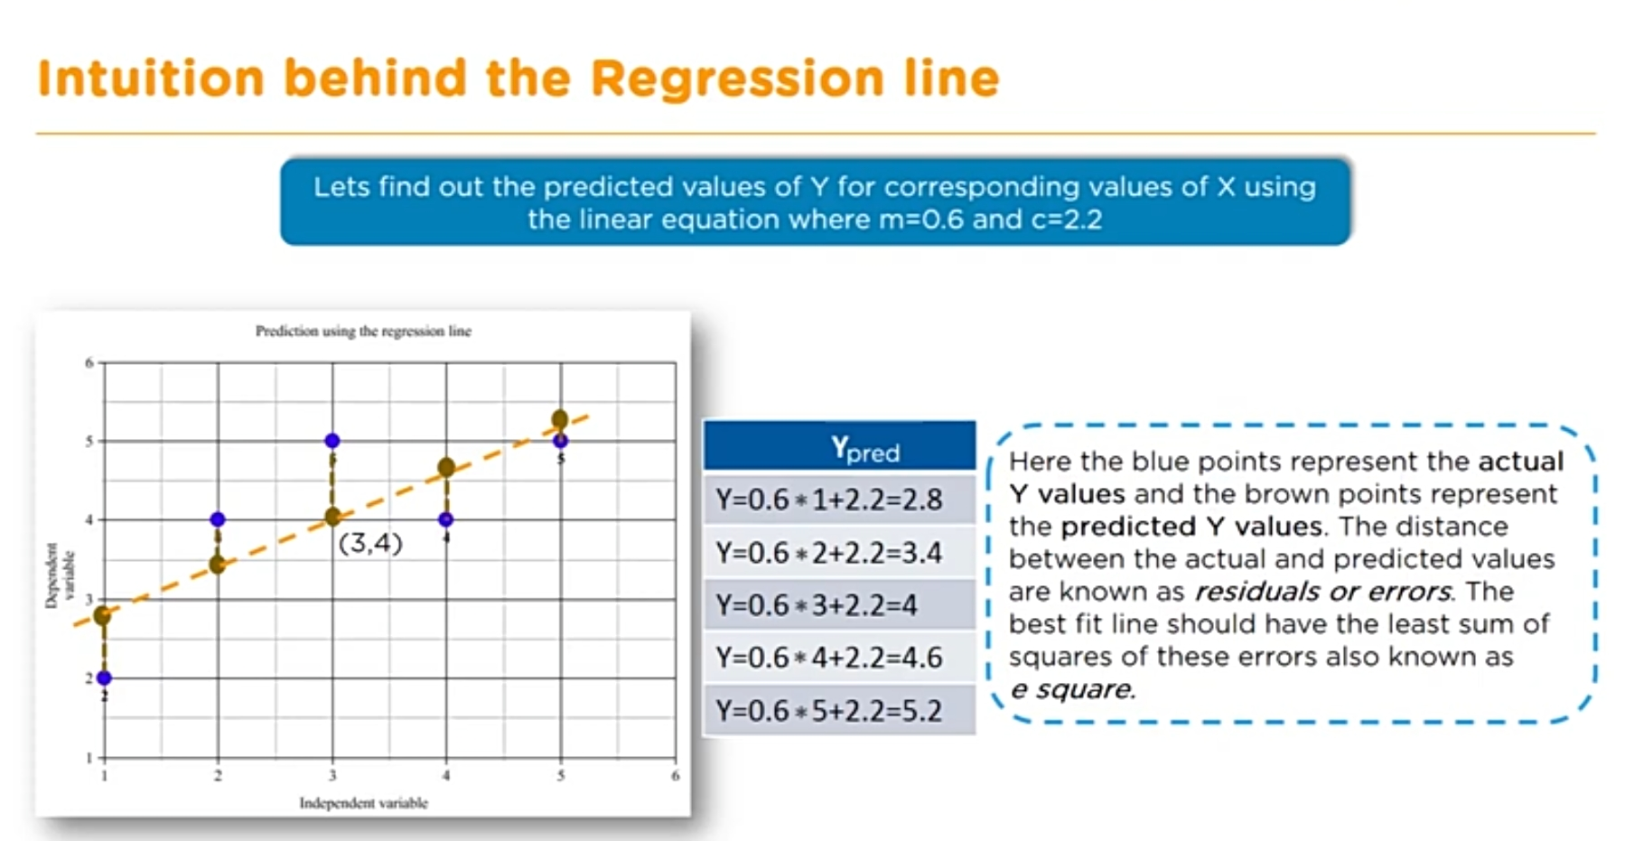

Slide 19
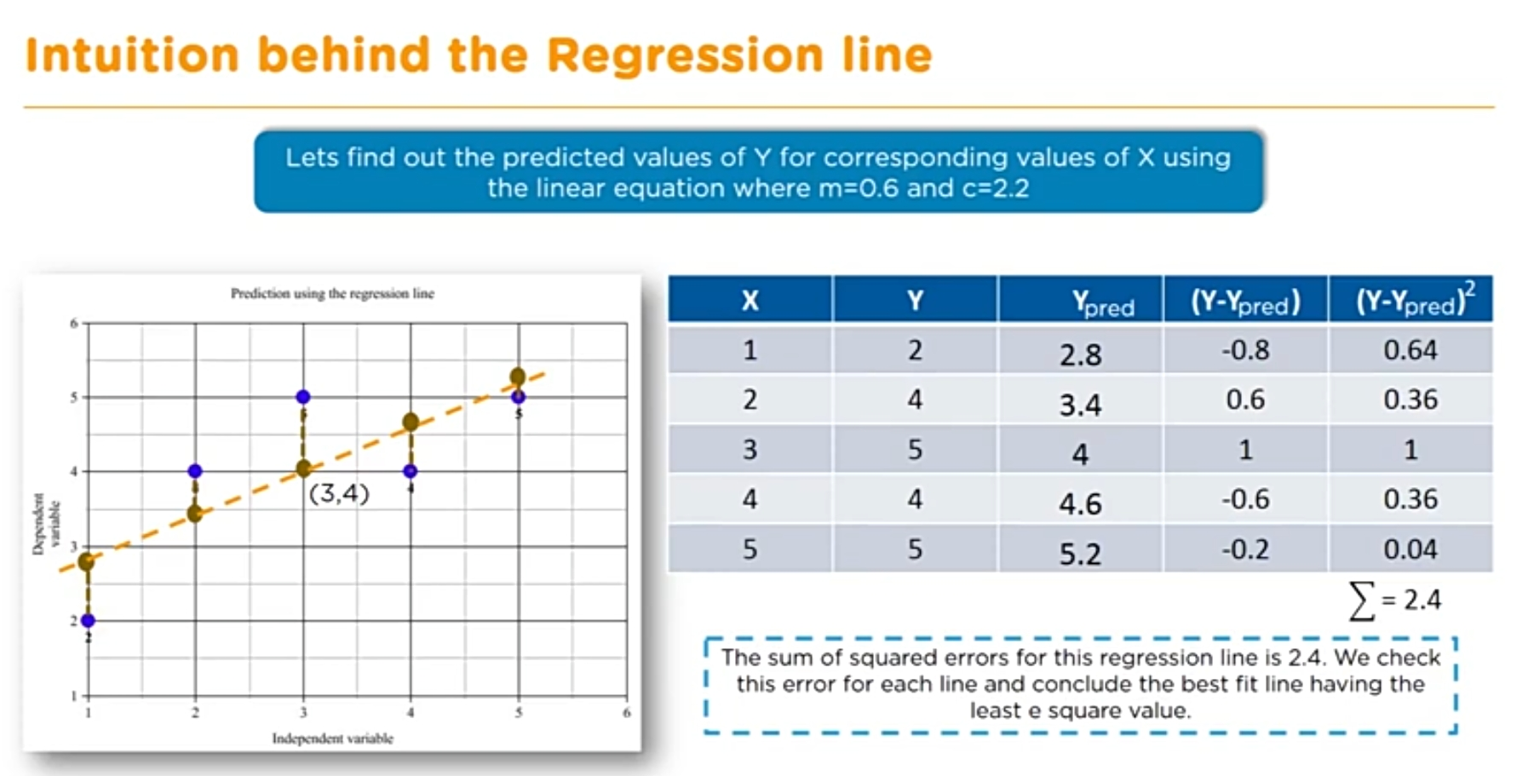

Slide 20
Once we find the best m and c values, we get the best fit line. So when we are finally using our model for prediction, it will predict the value of y for the input value of x.
How to update m and c values to get the best fit line ?
Cost Function (J): By achieving the best-fit regression line, the model aims to predict y value such that the error difference between predicted value and true value is minimum. So, it is very important to update the m and c values, to reach the best value that minimize the error between predicted y value (pred) and true y value (y).
Cost function(J) of Linear Regression is the Root Mean Squared Error (RMSE) between predicted y value (pred) and true y value (y).
Gradient Descent: To update m and c values in order to reduce Cost function (minimizing RMSE value) and achieving the best fit line the model uses Gradient Descent. The idea is to start with random m and c values and then iteratively updating the values, reaching minimum cost.

Slide 21
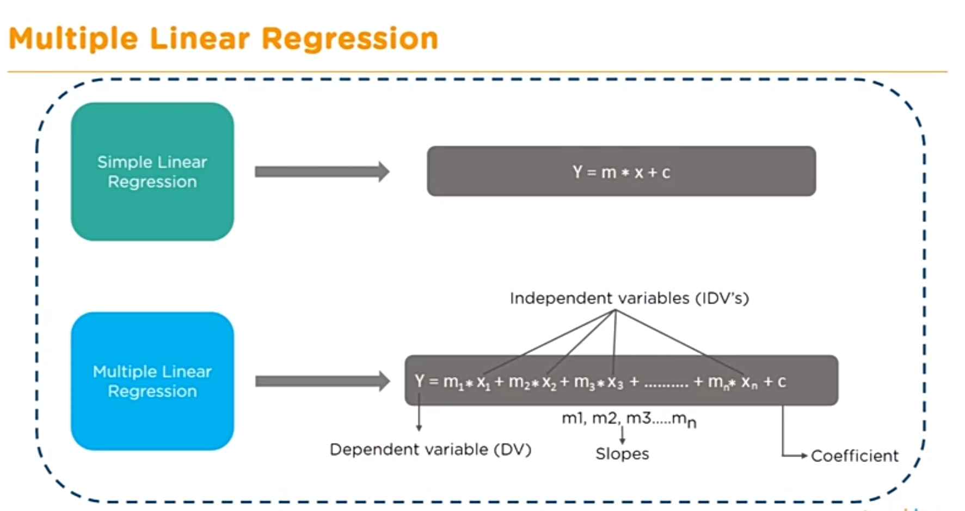

Slide 22
Different applications Linear Regression
Predicting the price of a product based on past data.
Predicting the price of todays weather based on past labeled data.
Estimating the profit of a company.
To estimate the number of houses a builder would sell and at what price in the coming months.
Predicting the health care costs.

Slide 23
Machine Learning – Programming languages support
Python
Python is the leader, with 57% of data scientists and machine learning developers using it and 33% preferring it over other languages for developments. Not only python is a widely-used language, but it is the primary choice for most of its users due to the release of TensorFlow and a wide selection of other libraries.
2. Java
Java is the second most preferred language used by data scientists and machine learning developers to implement ML algorithms.
The newest version of java that is java 11, has improved features for machine learning such as:
New string methods- isBlank, lines, repeat, stripLeading, stripTailing, and strip
New file methods- writeString, readString, and isSameFile
Pattern recognizing methods- asMatchPredicate, etc.
Java is regarded as a secure language due to its use of bytecode and sandboxes. It is no surprise that the latest as well as older machine learning algorithms are written in Java. It is a functional programming language that will allow future machine learning systems with speed, accuracy, and precision.

Slide 24
Java WEKA ML API
WEKA (Waikato Environment for Knowledge Analysis) is an open source library for machine learning, bundling lots of techniques from Support Vector Machines to C4.5 Decision Trees in a single Java package.
Weka is a standard open source Java tool for performing both machine learning experiments and for embedding trained models in Java applications. It can be used for supervised and unsupervised learning. There are three ways to use Weka first using command line, second using Weka GUI, and third through its API with Java.

Slide 25
Linear Regression Example
An example on Linear regression to predict the health care coverage costs based on certain input parameters.

Slide 26
Performance metrices for Linear Regression

Slide 27
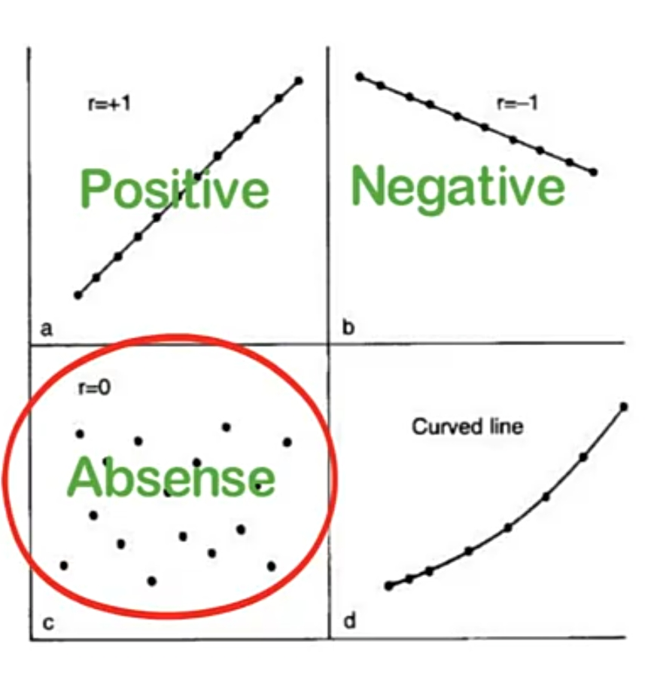
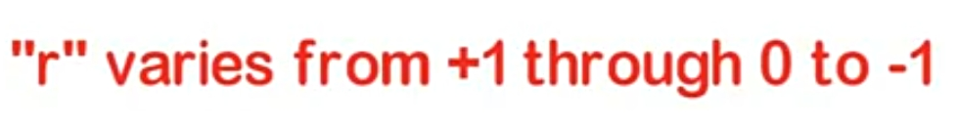
Correlation coefficient (r)
It specifies the relation ship between independent(x) and dependent(y) variables,
if x increases then y increases , then the value r will be positive.
If x increases then y decreases then the value r will be negative.
It will be used to measure the strength of the association between features.

Slide 28
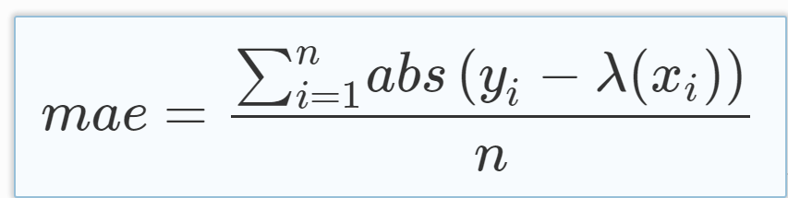
Mean Absolute Error
the Mean Absolute Error, also known as MAE, is one of the many metrics for summarizing and assessing the quality of a machine learning model.
Step 1 : Prediction Error → Actual Value - Predicted Value
Step 2 : Absolute Error → |Prediction Error|
Step 3: Finally we calculate the mean for all recorded absolute errors (Average sum of all absolute errors).
MAE = Average of All absolute errors
Small MAE suggests the model is great at prediction, while a large MAE suggests that your model may have trouble in certain areas. A MAE of 0 means that your model is a perfect predictor of the outputs (but this will almost never happen).

Slide 29
Absolute Error = Actual Value - Measured Value
Relative Error = Absolute Error / Actual Value
Root mean squared error(RMSE):
The RMSE is the square root of the variance of the residuals. It indicates the absolute fit of the model to the data–how close the observed data points are to the model’s predicted values.
Lower values of RMSE indicate better fit. RMSE is a good measure of how accurately the model predicts the response, and it is the most important criterion for fit if the main purpose of the model is prediction.

Slide 30
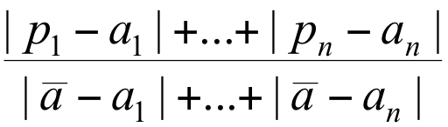
Relative Absolute Error (RAE)
RAE = MAE / sum of (average of actual values – actual value)
A good model will produce a ratio close to zero; A poor model will produce a ratio greater than one.

Slide 31
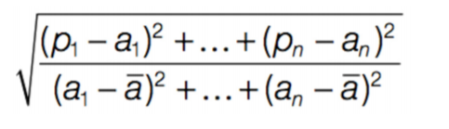
Root Relative Squared Error (RRSE)
RAE = Square root of ( sum of squares of absolute errors / sum of squares of (average of actual values – actual value))
A good model will produce a ratio close to zero; A poor model will produce a ratio greater than one.

Slide 32
Classification

Slide 33
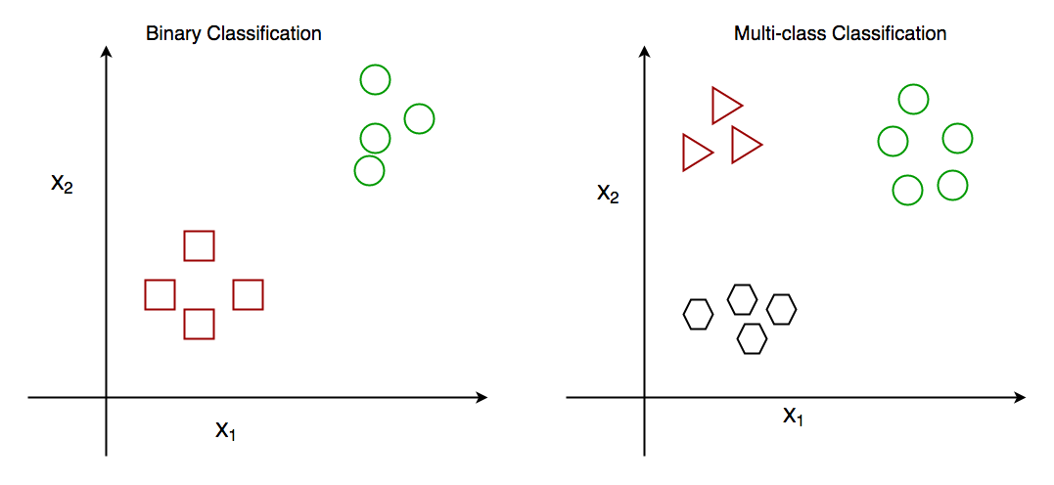
In Machine Learning, Classification is the problem of identifying to which of a set of categories (sub populations), a new observation belongs to, on the basis of a training set of data containing observations and whose categories membership is known.
Classification is of two types:
Binary Classification : When we have to categorize given data into 2 distinct classes. Example – On the basis of given health conditions of a person, we have to determine whether the person has a certain disease or not.
Multiclass Classification : The number of classes is more than 2. For Example – On the basis of data about different species of flowers, we have to determine which specie does our observation belong to.

Slide 34
How does classification works?
Suppose we have to predict whether a given patient has a certain disease or not, on the basis of 3 variables, called features.
Which means there are two possible outcomes:
The patient has the said disease. Basically a result labelled “Yes” or “True”.
The patient is disease free. A result labelled “No” or “False”.
This is a binary classification problem.
We have a set of observations called training data set, which comprises of sample data with actual classification results. We train a model, called Classifier on this data set, and use that model to predict whether a certain patient will have the disease or not.

Slide 35
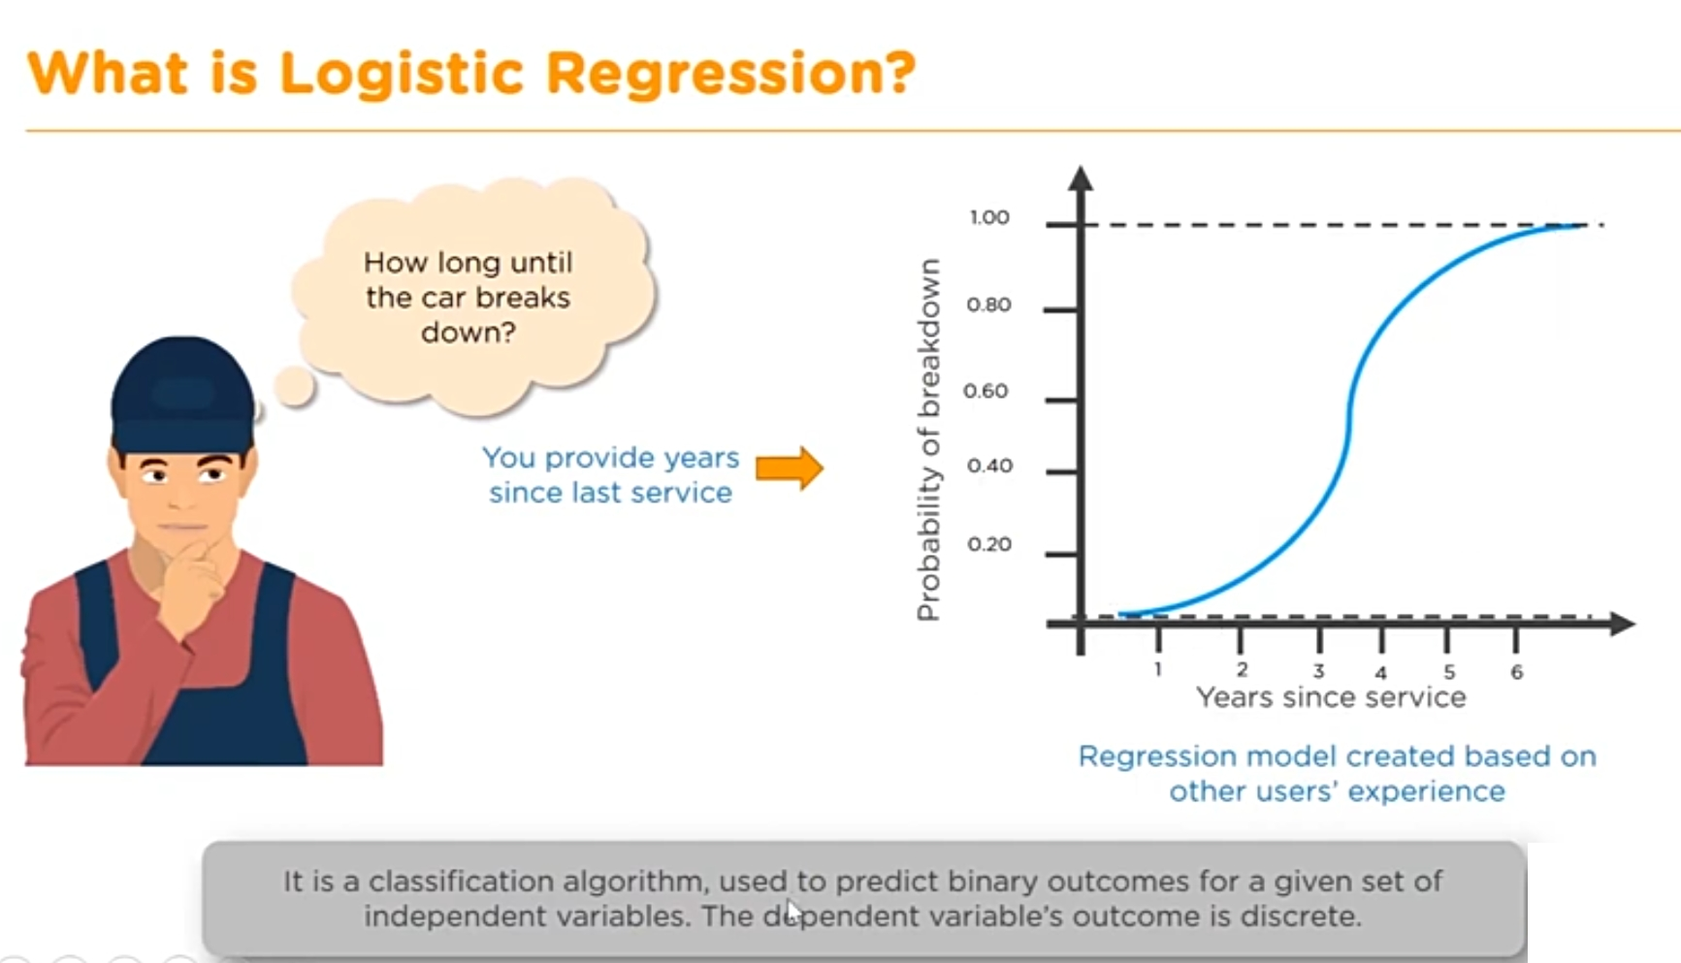

Slide 36
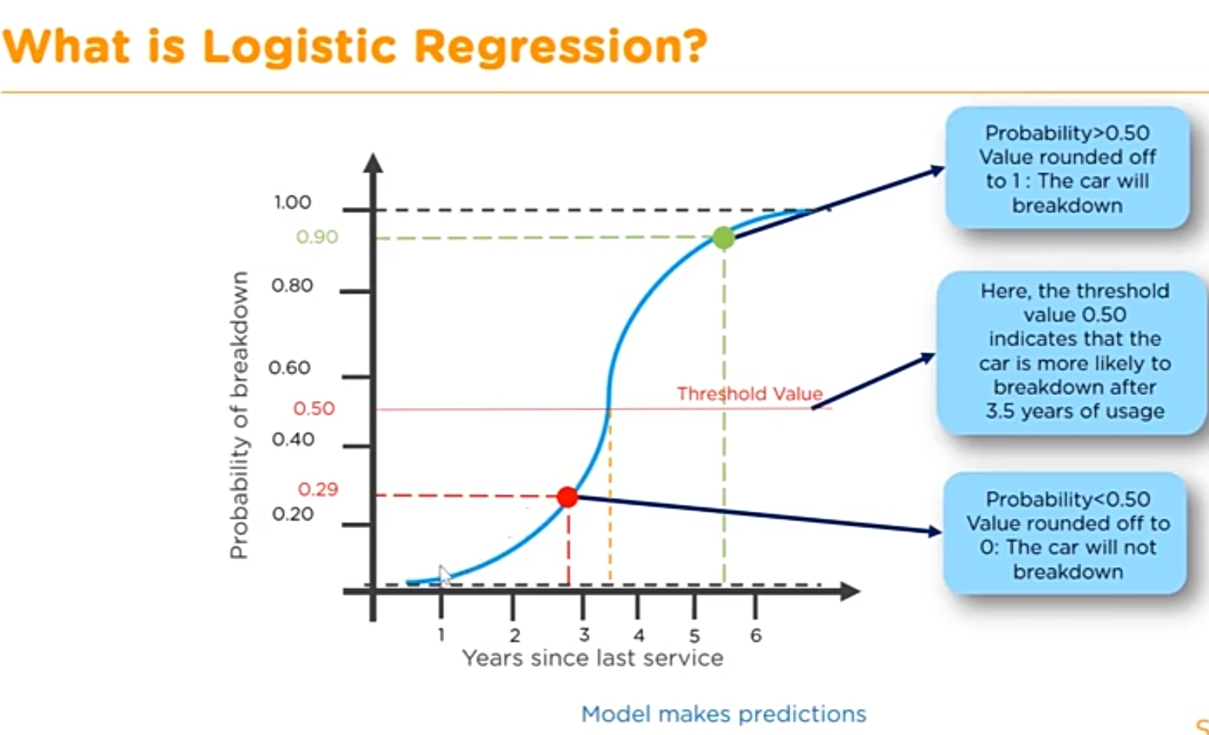

Slide 37
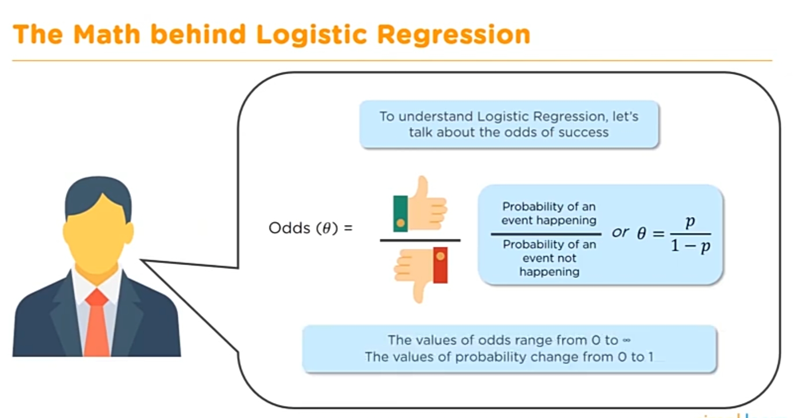

Slide 38
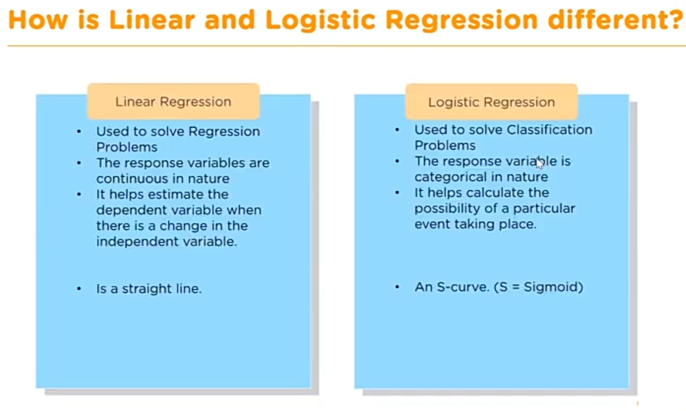

Slide 39
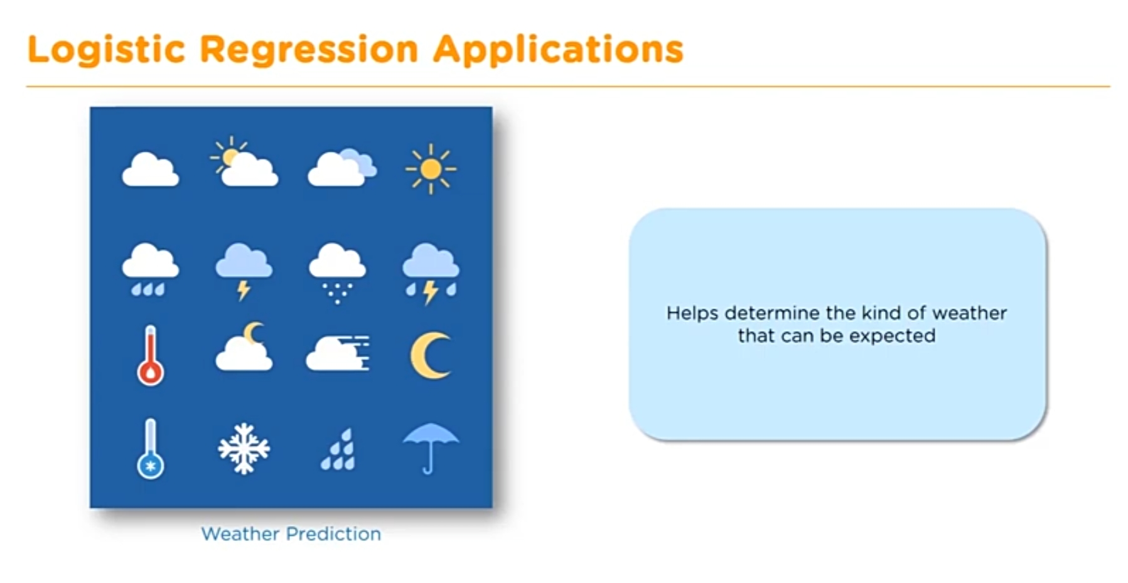

Slide 40
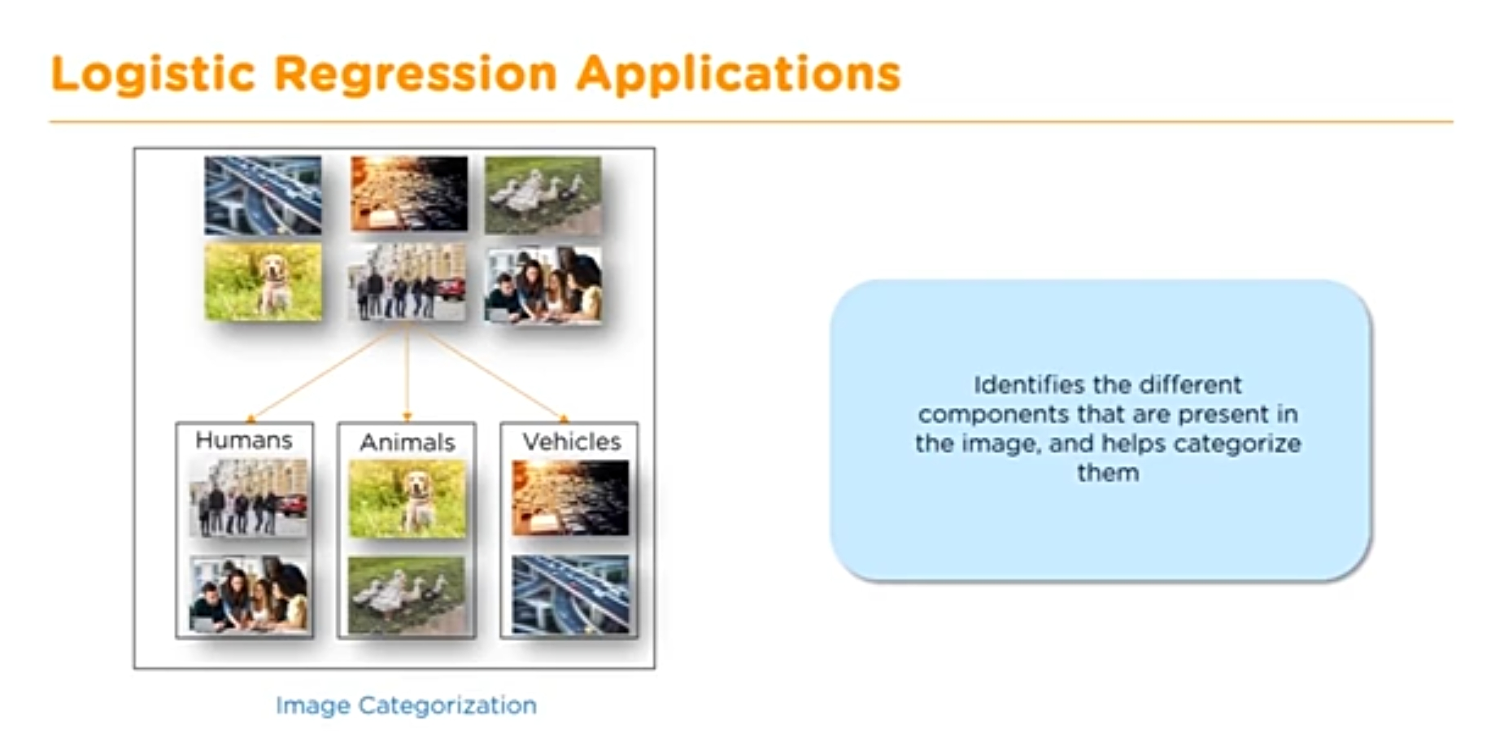

Slide 41
Classification Examples
Diabetic prediction for female patients
Text Classification
Chronic Heart Disease Predictor

Slide 42
Classification Metrices

Slide 43
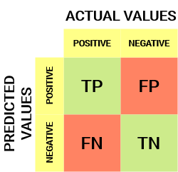
Confusion Matrix
A Confusion matrix is an N x N matrix used for evaluating the performance of a classification model, where N is the number of target classes. The matrix compares the actual target values with those predicted by the machine learning model. This gives us a holistic view of how well our classification model is performing and what kinds of errors it is making.
For a binary classification problem, we would have a 2 x 2 matrix as shown below with 4 values:
Let’s decipher the matrix:
The target variable has two values: Positive or Negative
The columns represent the actual values of the target variable
The rows represent the predicted values of the target variable

Slide 44
Understanding True Positive, True Negative, False Positive and False Negative in a Confusion Matrix
True Positive (TP)
The predicted value matches the actual value
The actual value was positive and the model predicted a positive value
True Negative (TN)
The predicted value matches the actual value
The actual value was negative and the model predicted a negative value
False Positive (FP) – Type 1 error
The predicted value was falsely predicted
The actual value was negative but the model predicted a positive value
Also known as the Type 1 error
False Negative (FN) – Type 2 error
The predicted value was falsely predicted
The actual value was positive but the model predicted a negative value
Also known as the Type 2 error

Slide 45
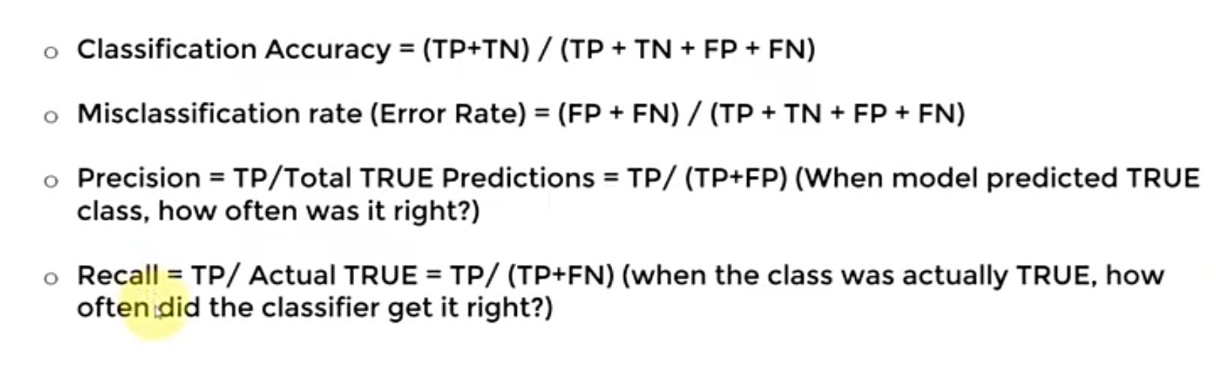
KEY PERFORMANCE INDICATORS (KPI)

Slide 46
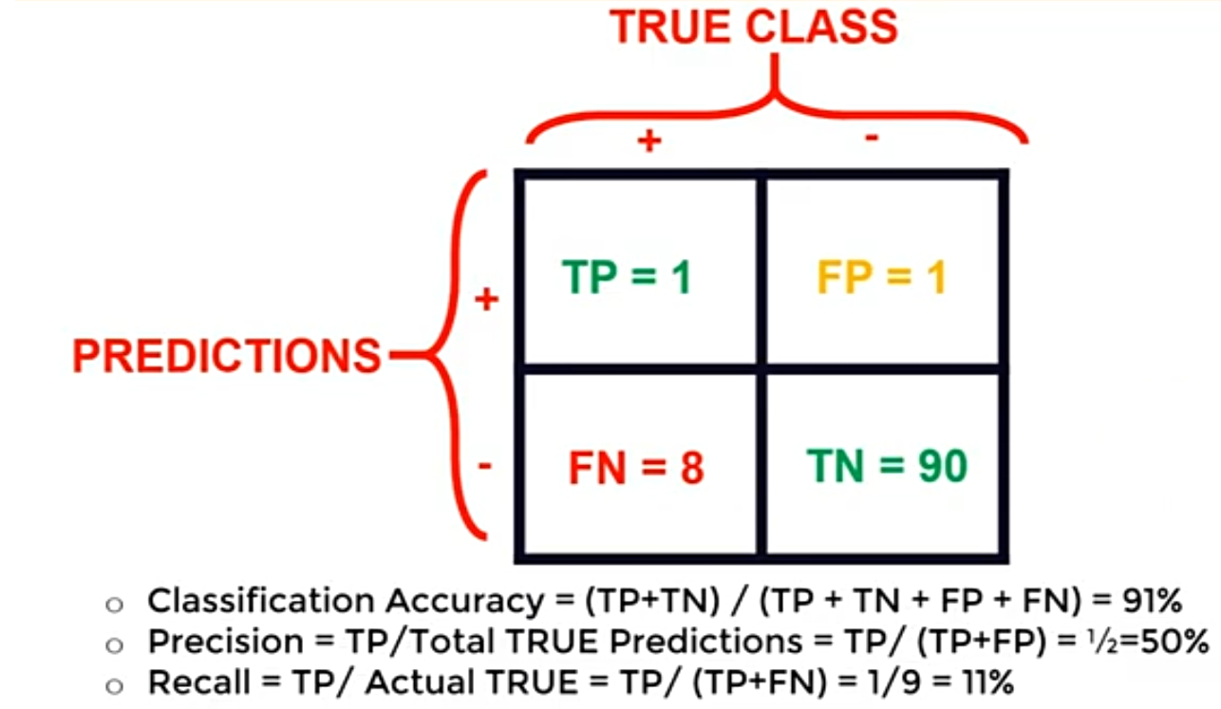
Use case to understand KPI :
Lets say we have 100 patients. Out of 100, 91 are totally fine , they don’t have any disease but 9 are actually diseased. So, the correct model should correctly predict these 9 patients who are at risk.
Lets assume the model has given the below outputs, now calculate KPI for this to assess the performance of an model.

Slide 47
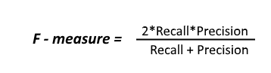
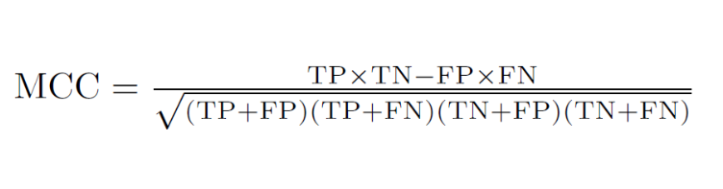
F1 Score
F1-score is a harmonic mean of Precision and Recall, and so it gives a combined idea about these two metrics. It is maximum when Precision is equal to Recall. The more F1 score, the model is accurate and good.
MCC
The Matthews Correlation Coefficient (MCC) has a range of -1 to 1 where -1 indicates a completely wrong binary classifier while 1 indicates a completely correct binary classifier. Using the MCC allows one to gauge how well their classification model/function is performing. It takes into account true and false positives and negatives and is generally regarded as a balanced measure which can be used even if the classes are of very different sizes.

Slide 48
Thank You

